Slide 1


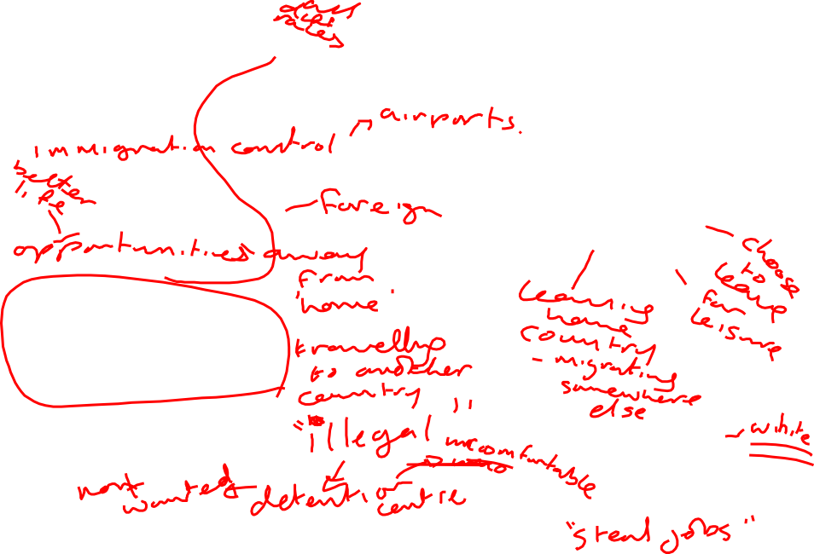
Reading Strategies
What connotations do you have of these two words? Mind-map as many things as you can think of.
Immigrant
Ex-pat
LOs
To understand how to approach unfamiliar non-fiction texts
To develop independence in approaching unfamiliar new texts
Notes:
These are the first images on google images that have people in them, when you search these two terms. Can tell them this.

Slide 2

You have a headline, strapline and extract from three different articles on immigration
Your job is to try and work out which ones come from the same article
Use all your knowledge to try and make links – how can you tell which extracts come from the same article?

Slide 3
Migrants storm Kent beaches: Border Force intercepts army of 66 men, women and even a baby landing at Dover after flotilla of boats makes a dash across the Channel at dawn
The group of 66 migrants were detected at first light this morning - now being quizzed by Border Force in Dover.
Search and rescue operations have been launched along the Kent coast amid a wave of migrant crossings of the English Channel.
CRISIS POINT Moment migrants storm Kent beaches as more than 270 descend on Britain in a WEEK
In all, 66 migrants discovered at dawn and taken in by Border Force yesterday
Men and women arrived on precariously small boats under cover of darkness
More than 1,000 migrants have crossed the Dover Strait already this year
Most of the migrants have claimed they are either Iraqi or Iranian
More than 50 migrants arrived on Kent beaches this morning bringing the number who have successfully crossed the channel into Britain to over 1,000 so far this year.
Border force officials scoured the English Channel yesterday after a fleet of dinghies carrying scores of suspected illegal migrants was intercepted on its way to the Kent coast.
Migrants scramble onto a Kent beach today amid a wave of more than 270 people descending onto Britain in just a week.
[strapline for a video]
Border Force intercept more than 50 migrants arriving at Dover

Slide 4
How did you do that?
What clues were you looking for?

Slide 5
The Telegraph
Border Force intercept more than 50 migrants arriving at Dover
More than 50 migrants arrived on Kent beaches this morning bringing the number who have successfully crossed the channel into Britain to over 1,000 so far this year.
Search and rescue operations have been launched along the Kent coast amid a wave of migrant crossings of the English Channel.

Slide 6
The Sun
CRISIS POINT Moment migrants storm Kent beaches as more than 270 descend on Britain in a WEEK
Migrants scramble onto a Kent beach today amid a wave of more than 270 people descending onto Britain in just a week.
[strapline for a video]
The group of 66 migrants were detected at first light this morning - now being quizzed by Border Force in Dover.

Slide 7
The Daily Mail
Migrants storm Kent beaches: Border Force intercepts army of 66 men, women and even a baby landing at Dover after flotilla of boats makes a dash across the Channel at dawn
In all, 66 migrants discovered at dawn and taken in by Border Force yesterday
Men and women arrived on precariously small boats under cover of darkness
More than 1,000 migrants have crossed the Dover Strait already this year
Most of the migrants have claimed they are either Iraqi or Iranian
Border force officials scoured the English Channel yesterday after a fleet of dinghies carrying scores of suspected illegal migrants was intercepted on its way to the Kent coast.

Slide 8
These three newspapers are all reporting the same story
Are they reporting it in the same way?
What similarities or differences do you notice?

Slide 9
Let’s look at the headlines. Highlight any emotive language you can find.
What emotion do you think the writers wanted to create in the reader?
What attitudes do they suggest?
Migrants storm Kent beaches: Border Force intercepts army of 66 men, women and even a baby landing at Dover after flotilla of boats makes a dash across the Channel at dawn
Border Force intercept more than 50 migrants arriving at Dover
CRISIS POINT Moment migrants storm Kent beaches as more than 270 descend on Britain in a WEEK

Slide 10
Migrants storm Kent beaches: Border Force intercepts army of 66 men, women and even a baby landing at Dover after flotilla of boats makes a dash across the Channel at dawn
Migrants storm Kent beaches: Border Force intercepts army of 66 men, women and even a baby landing at Dover after flotilla of boats makes a dash across the Channel at dawn
Border Force intercept more than 50 migrants arriving at Dover
Border Force intercept more than 50 migrants arriving at Dover
CRISIS POINT Moment migrants storm Kent beaches as more than 270 descend on Britain in a WEEK
CRISIS POINT Moment migrants storm Kent beaches as more than 270 descend on Britain in a WEEK

Slide 11
Read The Telegraph article
Reading steps:
Divide the text into 3 sections
Read each section carefully
Next to each section, write a quick summary of what the writer has said
Once you have read the text all the way through, re-read each section and highlight any language that you think shows the writer’s opinion
As you read it, pick out any interesting language that shows the writer’s view and attitudes to the story
Pick out any similarities or differences you spot in the writers attitude – pick out the words and language that show this.

Slide 12
The Sun
CRISIS POINT Moment migrants storm Kent beaches as more than 270 descend on Britain in a WEEK
Brittany Vonow
Migrants scramble onto a Kent beach today amid a wave of more than 270 people descending onto Britain in just a week.
The group of 66 migrants were detected at first light this morning - now being quizzed by Border Force in Dover.
It is understood they arrived in a number of small boats.
Several search and rescue operations have been taking place along the Kent Coast after the men, women and children arrived this morning.
A Coastguard Agency spokesperson said: "HM Coastguard has been co-ordinating a search and rescue response to a number of incidents on the Kent coast, working with Border Force, Kent Police and other partners."
Today's arrivals are just the latest amid the migrant crisis, which has seen more than 220 people, including at least 40 children, intercepted by UK and French authorities between Thursday last week and yesterday.
And it's barely a day after Home Secretary Priti Patel said she and her French counterpart are working to clamp down on migrants who try to make the perilous trip across the Channel.
Josh Hallam, of Help Refugees, said: “It is possible there will be an increased push of people trying to get across.”
A staggering 1,451 migrants are thought to have crossed the Channel so far this year – almost three times the number throughout the whole of 2018 - despite millions being spent on security measures to prevent crossings.
Of that figure, more than 200 have made it from France to Britain in August alone. Most of the migrants claim to be either Iran or Iraq nationals.
Only a handful of them – 65 - have been deported back overseas since January.
Two migrants are known to have died trying to cross the Channel in August, with a 48-year-old Iraqi man found dead after trying to swim over.
Worryingly, migrants are threatening to jump into the Channel to avoid being towed back to France.
Border Force sources claim immigrants are so desperate to reach Britain they are willing to risk their lives instead of being “rescued” by French boats.
The UK has already sent officers from Immigration Enforcement and the National Crime Agency to a centre in Calais to try and tackle the gangs running the cross-Channel trafficking.
Dover and Deal MP Charlie Elphicke said: “This is an ­ominous development. We need immediate action.”
The Telegraph
Border Force intercept more than 50 migrants arriving at Dover
More than 50 migrants arrived on Kent beaches this morning bringing the number who have successfully crossed the channel into Britain to over 1,000 so far this year.
Search and rescue operations have been launched along the Kent coast amid a wave of migrant crossings of the English Channel.
While Border Force is responding to a "number of incidents" out at sea, Kent Police said that eight people suspected of getting out of a dinghy on the shore at Kingsdown have been passed to immigration officers on Saturday morning.
Coastguard rescue teams were sent from Folkestone and Deal to help with the operations on Saturday morning.
Their spokeswoman said that crews are concerned with "rescuing those in trouble and bringing them safely back to shore, where they will be handed over to the relevant partner emergency services or authorities"
She added: "HM Coastguard has been coordinating a search and rescue response to a number of incidents on the Kent coast, working with Border Force, Kent Police and other partners."
By Friday more than 220 migrants, including at least 40 children, had been intercepted by UK and French authorities since Thursday last week.
Home Secretary Priti Patel said on Friday that urgent action is needed to tackle the migrant crisis in the Channel, adding that plans are being drawn up "immediately" to deal with the problem.
Her comments came following a meeting with French interior minister Christophe Castaner in Paris on Thursday, where the pair agreed to step up resources to intercept and stop the wave of crossings in small boats.
The prospect of British financial support for efforts to stem the flow of crossings from France was discussed at the meeting, according to the French AFP news agency, and Mr Castaner said that money from London would "reinforce patrols and improve effectiveness".
Last week Prime Minister Boris Johnson warned illegal migrants they would be sent back if they risked crossing the Channel.
He said: "If you come illegally, you are an illegal immigrant and I'm afraid the law will treat you as such."
The Home Office have been approached for comment.
Notes:
Sun and Telegraph

Slide 13
Daily Mail
Migrants storm Kent beaches: Border Force intercepts army of 66 men, women and even a baby landing at Dover after flotilla of boats makes a dash across the Channel at dawn
ROSS IBBETSON
In all, 66 migrants discovered at dawn and taken in by Border Force yesterday
Men and women arrived on precariously small boats under cover of darkness
More than 1,000 migrants have crossed the Dover Strait already this year
Most of the migrants have claimed they are either Iraqi or Iranian
Border force officials scoured the English Channel yesterday after a fleet of dinghies carrying scores of suspected illegal migrants was intercepted on its way to the Kent coast.
In all, 66 people were detained and were being dealt with by immigration officers.
Some had been aboard vessels which were intercepted by Border Force officials while others were detained after managing to make it ashore.
Kent Police said eight people arrived in a dinghy on the shore at Kingsdown at 8.15am and were passed onto immigration officers.
One incident saw a boat carrying 27 adults and eight children intercepted. At the same time, another vessel carrying 16 people was escorted to Dover.
One group aboard a dinghy came ashore on the beach at Kingsdown, three miles south of the town of Deal.
Its eight male occupants – all Iranian – were detained by police and handed over to immigration officers.
Migrants aboard other vessels included Iraqi, Syrian and Kuwaiti nationals.
Coastguard chiefs said alerts to search-and-rescue teams had gone out in response to a ‘number of incidents’.
As of today more than 270 migrants, including at least 40 children, have been intercepted by UK and French authorities since Thursday last week.
Home Secretary Priti Patel said on Friday that urgent action was needed to tackle the Channel’s migrant crisis, adding that plans were being drawn up ‘immediately’ to deal with the problem. Her comments came after a meeting with French interior minister Christophe Castaner in Paris, during which the pair agreed to allocate more resources to intercept and stop the wave of crossings.
Last week, Prime Minister Boris Johnson warned migrants that they would be sent back if they risked crossing the Channel. He said: ‘If you are an illegal immigrant, I’m afraid the law will treat you as such.’
In June, eight boats with 74 people on board, including at least one child, landed on a stretch of coast between Dover in Kent and Winchelsea Beach in East Sussex over the course of a single morning.
Last year, 539 people attempted to travel to Britain on small boats, of whom 434 made their crossings in the last three months of the year, according to official figures.
The total number of migrants who have made it across the Dover Strait - the world's busiest shipping lane - has exceed 1,000 already this year, despite millions being spent on security measures to prevent crossings.
Most of the migrants claim to be either Iran or Iraq nationals.
Since January, some 1,450 migrants have been rescued either by British or French coastguards - more than double the number who tried to cross the busy shipping lane in the whole of 2018, according to official French figures released Monday.
France has attributed the increase to good summer weather, which has emboldened more migrants to make the journey.
However, such crossings are dangerous given the heavy maritime traffic in the Channel as well as strong currents and cold water.
The body of an Iraqi migrant who tried to swim across the Channel to Britain was found off Belgium's coast earlier this week, wearing a makeshift life jacket made of empty plastic bottles.
Officials believe the 48-year-old drowned after setting off from a beach in northern France, with currents dragging him into Belgian waters.
Published: 11:26, 31 August 2019 | Updated: 09:31, 2 September 2019
The Telegraph
Border Force intercept more than 50 migrants arriving at Dover
More than 50 migrants arrived on Kent beaches this morning bringing the number who have successfully crossed the channel into Britain to over 1,000 so far this year.
Search and rescue operations have been launched along the Kent coast amid a wave of migrant crossings of the English Channel.
While Border Force is responding to a "number of incidents" out at sea, Kent Police said that eight people suspected of getting out of a dinghy on the shore at Kingsdown have been passed to immigration officers on Saturday morning.
Coastguard rescue teams were sent from Folkestone and Deal to help with the operations on Saturday morning.
Their spokeswoman said that crews are concerned with "rescuing those in trouble and bringing them safely back to shore, where they will be handed over to the relevant partner emergency services or authorities"
She added: "HM Coastguard has been coordinating a search and rescue response to a number of incidents on the Kent coast, working with Border Force, Kent Police and other partners."
By Friday more than 220 migrants, including at least 40 children, had been intercepted by UK and French authorities since Thursday last week.
Home Secretary Priti Patel said on Friday that urgent action is needed to tackle the migrant crisis in the Channel, adding that plans are being drawn up "immediately" to deal with the problem.
Her comments came following a meeting with French interior minister Christophe Castaner in Paris on Thursday, where the pair agreed to step up resources to intercept and stop the wave of crossings in small boats.
The prospect of British financial support for efforts to stem the flow of crossings from France was discussed at the meeting, according to the French AFP news agency, and Mr Castaner said that money from London would "reinforce patrols and improve effectiveness".
Last week Prime Minister Boris Johnson warned illegal migrants they would be sent back if they risked crossing the Channel.
He said: "If you come illegally, you are an illegal immigrant and I'm afraid the law will treat you as such."
The Home Office have been approached for comment.
Notes:
Mail and Telegraph

Slide 14
Capture some of your ideas
Don’t forget to use quotes to back up your ideas and try to infer what they might suggest
In _, when the writer writes ‘…’ this suggests the migrants coming to the UK are __________ because …
The word / phrase / adjective ‘…’ makes me think of … and suggests that the writer thinks …

Slide 15
Read one of the other articles
Reading steps:
Divide the text into 3 sections
Read each section carefully
Next to each section, write a quick summary of what the writer has said
Once you have read the text all the way through, re-read each section and highlight any language that you think shows the writer’s opinion
On the left hand side, you have either a Daily Mail or The Sun article.
As you read it, pick out any interesting language that shows the writer’s view and attitudes to the story
Notes:
Daily Mail or Sun

Slide 16
Capture some of your ideas
In The … article, when the writer writes ‘…’ this suggests the migrants coming to the UK are __________ because …
This is similar / different to … in that …
The word / phrase / adjective ‘…’ makes me think of … and suggests that the writer thinks …

Slide 17



Which of these reading skills do you think you have used in this lesson?
How/when?

Slide 18

Consolidate: in your books
Which reading skills did you use in this lesson? When did you use them?
I used…. when we…
2. What similarities did you notice between the way the two articles were written?
3. What differences did you notice between the way the two articles were written?
4. How could these reading skills be useful when approaching unfamiliar texts in the future?

