Slide 1
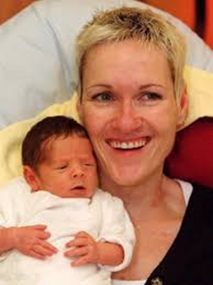
Tolerance, Acceptance, Respect

Slide 2
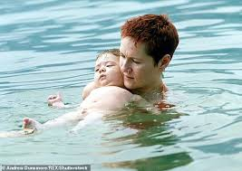
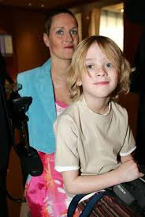

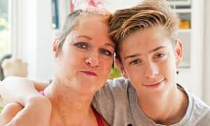
What is the story?

Slide 3
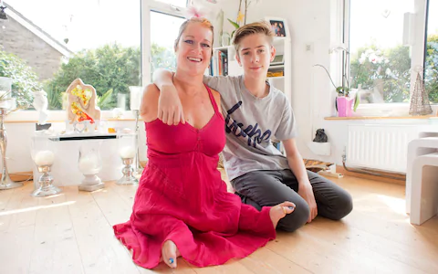
What is the story?
Notes:
Lapper was born with the condition phocomelia, meaning she has no arms and shortened legs.

Slide 4
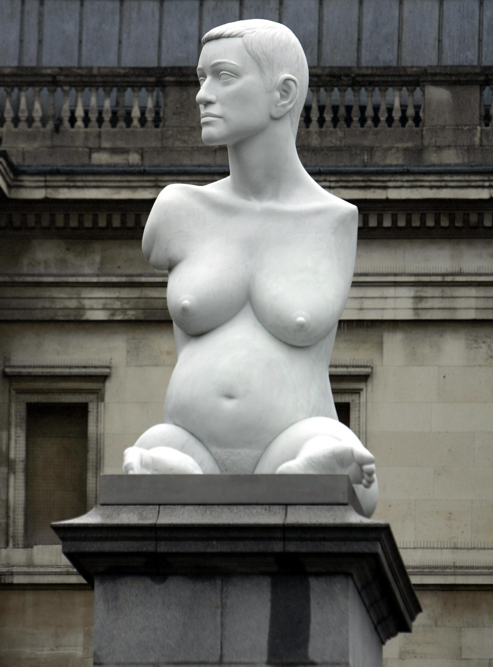
Alison Lapper Pregnant by Marc Quinn
Mark Quinn sculpted Alison Lapper for the Fourth Plinth in Trafalgar Square. She was pregnant. The 3.5 metre sculpture represents someone who has overcome their own circumstances through what he calls “a different kind of heroism”.
The sculpture celebrates in a very public way the beauty of a different body, and makes us question the narrow binds of acceptability into which social norms tend to push us. As well as being an artwork, the sculpture’s presence in Trafalgar Square has been hugely empowering in the progress of disabled rights in the UK.

Slide 5
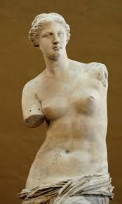
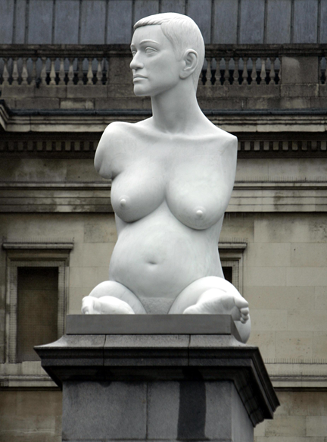
Venus de Milo
by Alexandros (150 BCE)
Alison Lapper
by Marc Quinn (2005 AD)

Slide 6
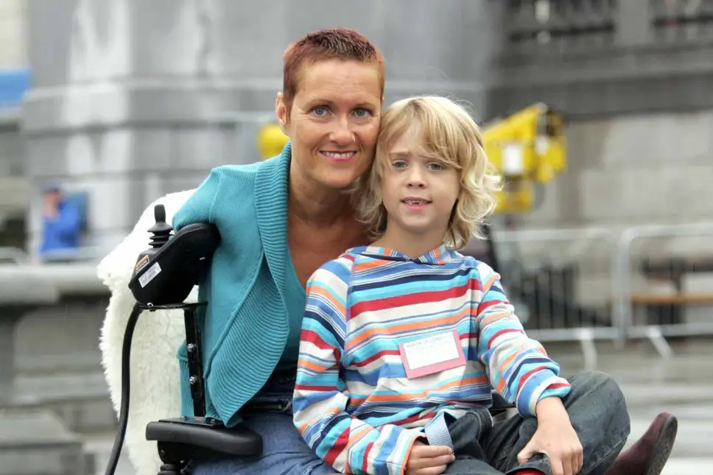
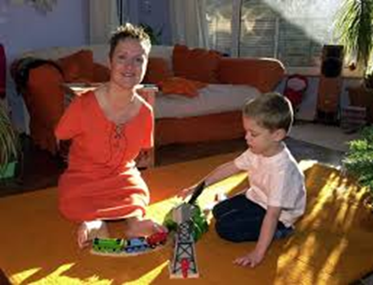
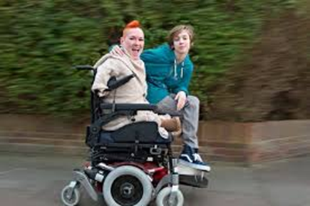
Alison Lapper and her son, Parys

Slide 7
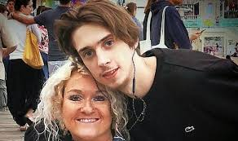
Parys Lapper, 19, was found in a hotel in Worthing, West Sussex in August 2019 after he died from a suspected accidental drug overdose.
His mother, Alison Lapper, said he had suffered with depression and anxiety after being bullied at school. Parys had asked her to stop attending parents’ evenings when he was 13.
She says that when they arrived at the school “We were the show. The next day Parys would go in and they would rip pieces out of him.”

Slide 8
During this period, said Lapper, he spent more time online, which furthered his declining mental health.
“Parys didn’t like his body,” she said. “I thought I could teach him to, but it’s a social media nightmare, isn’t it? There’s always someone with a six-pack or bigger.”
She added that the irony of her son’s concerns about his image was not lost on her. “Look at me, for God’s sake,” she said, “and I really love my body. I’m not ashamed about it at all.”
Lapper said: “I don’t want my son to be remembered as a junkie, as just another drugs death. The drugs were a consequence of what he had been through.”

Slide 10

Disability Discrimination
The Equality Act 2010 says that you must not be discriminated against because:
  you have a disability
  someone thinks you have a disability (this is known as discrimination by perception)
  you are connected to someone with a disability (this is known as discrimination by association)

Slide 11
Reflection:

Slide 12
We were the show. The next day Parys would go in and they would rip pieces out of him..
How do we treat people who look or behave differently?
How welcoming are we as a community to people with disabilities or mental health issues?
What could we do better as a community to support each other?

