Slide 1
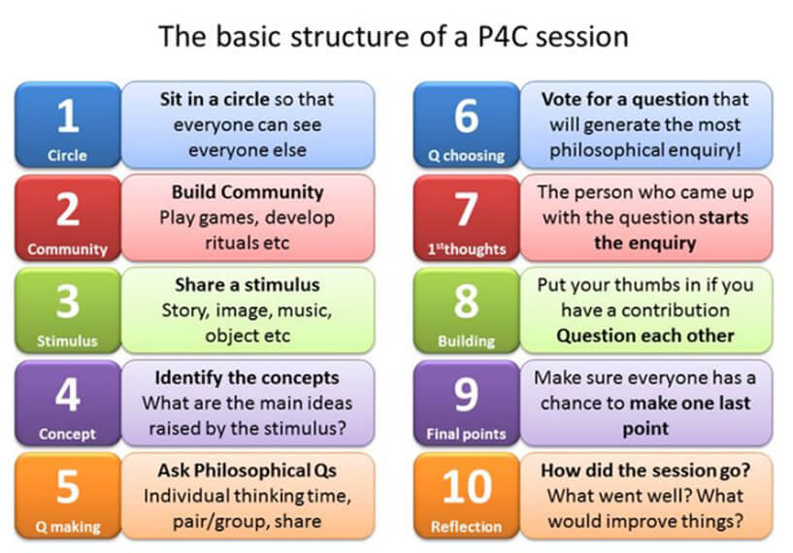

Slide 2

Predict: we are going to read an article called “Top Boy holds the antidote to this brutal government” – what do you think it will be about?
Dictionary search: antidote
L.I. to use media stimuli for a P4C discussion.

Slide 3


Fastest finger first!
Emotive
Immigration
Brutality
Resonates
Tussling
Extortionate
Insidious
Waiver
Hostility
Morality
You will be shown a word from the extract on the board.
Skim and Scan the text to find the word.
Fastest finger wins a ClassCharts point.
L.I. to use media stimuli for a P4C discussion.

Slide 4
Emotive
Immigration
Brutality
Resonates
Tussling
Extortionate
Insidious
Waiver
Hostility
Morality
the action of coming to live permanently in a foreign country
the extent to which an action is right or wrong
hostile behaviour; unfriendliness or opposition.
proceeding in a gradual, subtle way, but with very harmful effects.
arousing or able to arouse intense feeling.
seen as a party giving up its rights to take action or enforce its rights.
savage physical violence; great cruelty.
to produce a positive feeling, emotional response, or opinion.
much too high.
engage in a vigorous struggle or scuffle.
Match the words to their definition
L.I. to use media stimuli for a P4C discussion.

Slide 5

Further predictions
With the words you have defined, can you make any further predictions about the text?
I predict the text will be about ____________________________________________________________
because the words __________________________________ suggest ________________________________
________________________________________________________________________________________
________________________________________________________________________________________
________________________________________________________________________________________

Slide 6
We’re now going to read the article. As we do, what questions does it get you to ask?
Is there a problem with immigration in the UK?
Is it fair to blame the government?
What could solve the crisis in immigration?
What are the positive and negative effects of the community responding like those in Top Boy and the article?
L.I. to use media stimuli for a P4C discussion.

Slide 7
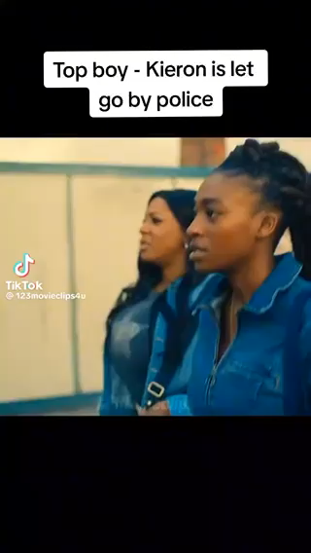
Top Boy clips
Ashley Walters
What questions do these clips raise for you?
L.I. to use media stimuli for a P4C discussion.
Notes:
Youtube 2 mins 50 seconds
The questions they ask here will work towards the key concepts for discussion.

Slide 8
Glasgow Immigration Raid
This is a real clip of something very similar happening.
How does this make you feel?
What are the possible issues raised here?

Slide 9
Now let’s now have our P4C discussion.
We are here.

Slide 10


Reflection
From today’s lesson, what is one thing you can take to contribute positively to your community?

