Slide 1

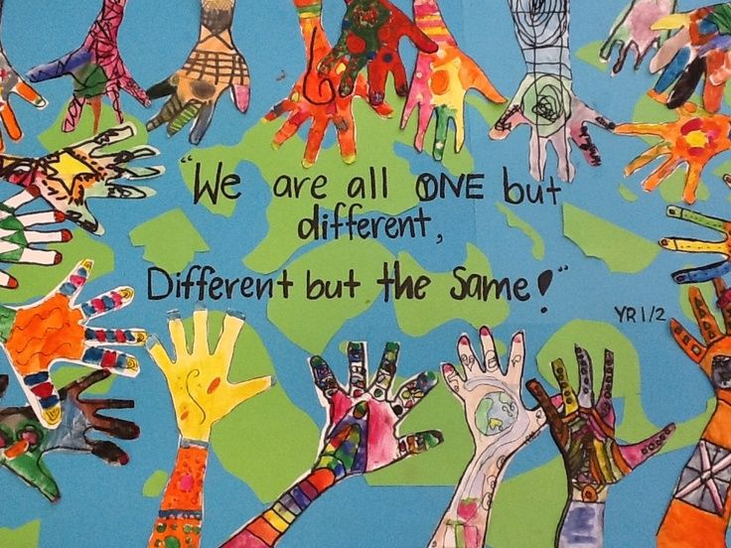
Multiculturalism Week
LO: to celebrate Multiculturalism Week through poetry
What does multiculturalism mean?
How might the picture relate to this idea?
What is your culture?
This might include:
Where you or your family are from
Things you like to do
Family traditions
Religion
Cultural clothes
Food

Slide 2
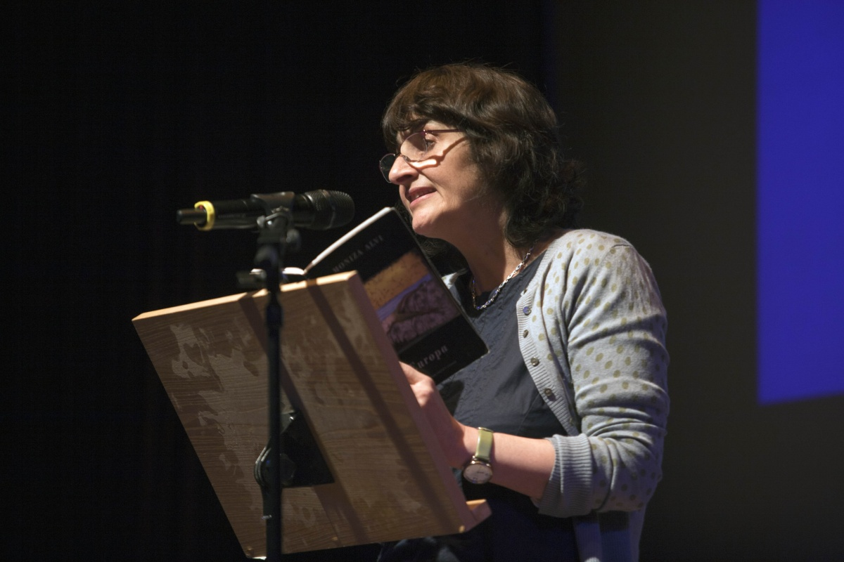
Many of Moniza Alvi’s poems draw from her experiences as a mixed race woman, born in Pakistan but brought up in England. In this poem, the narrator, who could be Alvi herself, describes the experience of having a henna tattoo of a peacock drawn on her hand by a young girl in a bazaar in India.
We are going to read her poem An Unknown Girl
What does it mean to feel unknown?
Have you ever been in a situation where you felt unknown?
What did it feel llike?

Slide 3
An Unknown Girl by Monica Aziz
In the evening bazaar
Studded with neon
An unknown girl
Is hennaing my hand
She squeezes a wet brown line
Form a nozzle
She is icing my hand,
Which she steadies with her
On her satin peach knee.
In the evening bazaar
For a few rupees
An unknown girl is hennaing my hand
As a little air catches
My shadow stitched kameez
A peacock spreads its lines
Across my palm.
Colours leave the street
Float up in balloons.
Dummies in shop-fronts
Tilt and stare
With their western perms.
Banners for Miss India 1993
For curtain cloth
And sofa cloth
Canopy me.
I’m going to read it to you three times.
The first time, listen to the words.
Write down any questions you have.
What do you wonder?
I have new brown veins.
In the evening bazaar​
Very deftly​
An unknown girl​
is hennaing my hand​
I am clinging​
To these firm peacock lines​
Like people who cling​
to sides of a train.​
Now the furious streets​
Are hushed.​
I’ll scrape off​
The dry brown lines​
Before I sleep,​
Reveal soft as a snail trail​
The amber bird beneath.​
It will fade in a week.​
When India appears and reappears​
I’ll lean across a country​
With my hands outstretched​
Longing for the unknown girl​
In the neon bazaar.​
​
The second time, follow the words on the page.
Highlight any words or phrases that jump out to you or you particularly like.
What do you notice?
The third time write down any emotions you can see or any emotions you feel as you hear the words.
What do you feel?

Slide 4
What is important to Aziz?
Let’s make a list
What is important to you? (this might be people in your life, from your past, future plans, precious possessions, pets, memories)
Make a list. You don’t have to share this list so be as honest as you want.

Slide 5
An Unknown Girl by Monica Aziz
In the evening bazaar
Studded with neon
An unknown girl
Is hennaing my hand
She squeezes a wet brown line
Form a nozzle
She is icing my hand,
Which she steadies with her
On her satin peach knee.
In the evening bazaar
For a few rupees
An unknown girl is hennaing my hand
As a little air catches
My shadow stitched kameez
A peacock spreads its lines
Across my palm.
Colours leave the street
Float up in balloons.
Dummies in shop-fronts
Tilt and stare
With their western perms.
Banners for Miss India 1993
For curtain cloth
And sofa cloth
Canopy me.
I have new brown veins.
In the evening bazaar​
Very deftly​
An unknown girl​
is hennaing my hand​
I am clinging​
To these firm peacock lines​
Like people who cling​
to sides of a train.​
Now the furious streets​
Are hushed.​
I’ll scrape off​
The dry brown lines​
Before I sleep,​
Reveal soft as a snail trail​
The amber bird beneath.​
It will fade in a week.​
When India appears and reappears​
I’ll lean across a country​
With my hands outstretched​
Longing for the unknown girl​
In the neon bazaar.​
​
Do you like this poem?
Why?
Why not?
What makes a good poem?
Let’s make another list!

Slide 6
Now it’s your turn to write a poem.
Choose one of the following ideas below to guide you.
Write a poem about something that is important to you.
Write a poem titled Unknown
Write a poem inspired by the picture.
Write a poem titled Multiculturalism

Slide 7
Swap poems with your neighbour.
Read their poem
Write down one thing you love about their poem
Write down one thing that might improve their poem
  Have they used poetic devices such as stanzas, rhyme, metaphors, similes or repetition
  Are their ideas clear and easy to find?
  Have they included emotions?
When you get your poem back, read your feedback.
Do you want to make any changes?

Slide 8

Let’s have a poetry showcase.
Get into groups of four or five
Read out your poem to your group.
Between you decide which ones should be read out to the whole class.

Slide 9
An Unknown Girl by Monica Aziz
In the evening bazaar
Studded with neon
An unknown girl
Is hennaing my hand
She squeezes a wet brown line
Form a nozzle
She is icing my hand,
Which she steadies with her
On her satin peach knee.
In the evening bazaar
For a few rupees
An unknown girl is hennaing my hand
As a little air catches
My shadow stitched kameez
A peacock spreads its lines
Across my palm.
Colours leave the street
Float up in balloons.
Dummies in shop-fronts
Tilt and stare
With their western perms.
Banners for Miss India 1993
For curtain cloth
And sofa cloth
Canopy me.
I have new brown veins.
In the evening bazaar​
Very deftly​
An unknown girl​
is hennaing my hand​
I am clinging​
To these firm peacock lines​
Like people who cling​
to sides of a train.​
Now the furious streets​
Are hushed.​
I’ll scrape off​
The dry brown lines​
Before I sleep,​
Reveal soft as a snail trail​
The amber bird beneath.​
It will fade in a week.​
When India appears and reappears​
I’ll lean across a country​
With my hands outstretched​
Longing for the unknown girl​
In the neon bazaar.​
​

